Slide 1

CDL Delivery Order(DO) and Invoice Reading
Jan'24

Slide 2
AGENDA
Project Background and objective
PyTesseract Results vs Azure Cloud results
Implementation Plans

Slide 3


BACKGROUND & OBJECTIVE
On a monthly basis, the operations team pays vendor(PAMAC finserv) 8-10 lacs to manually review the invoices and DO in order to categorize the case as FTR or FTNR. The Retail-Operations team is trying to reduce costs by automating this process.
To create a platform that will use OCR techniques to classify the cases as FTR or FTNR

Slide 4











The Roadmap
Detecting and comparing information from two bills, CDL Delivery Order (DO) and Invoice, involves several steps and technologies. Here's a roadmap using various technologies
TEXT EXTRACTION
ADVANCE ANALYSIS
Objective: Extract text information from bills.
Research and Library Installation
Technologies:
EasyOCR for general text extraction.
Pytesseract for additional OCR capabilities.
Technology: Azure Computer Vision for image analysis and feature extraction.
2-3 DAYS
1-2 DAYS
2-3 DAYS
25-30 DAYS
1-2 DAYS
IMAGE PROCESSING
DATA VALIDATION AND CLEANING
ANALYTICAL SYNTHESIS
Objective: Convert bills to structured data.
Technology: Image2Tables for tabular data extraction.
Objective: Summarize comparison results.
Action:
Custom Similarity Algorithm: Utilize a custom-made similarity algorithm to compare fields of both bills.
Objective: Ensure accuracy by validating and cleaning extracted data.
Techniques:
Regular Expression (Regex): Utilize Regex for text correction and pattern identification during data cleaning.

Slide 5
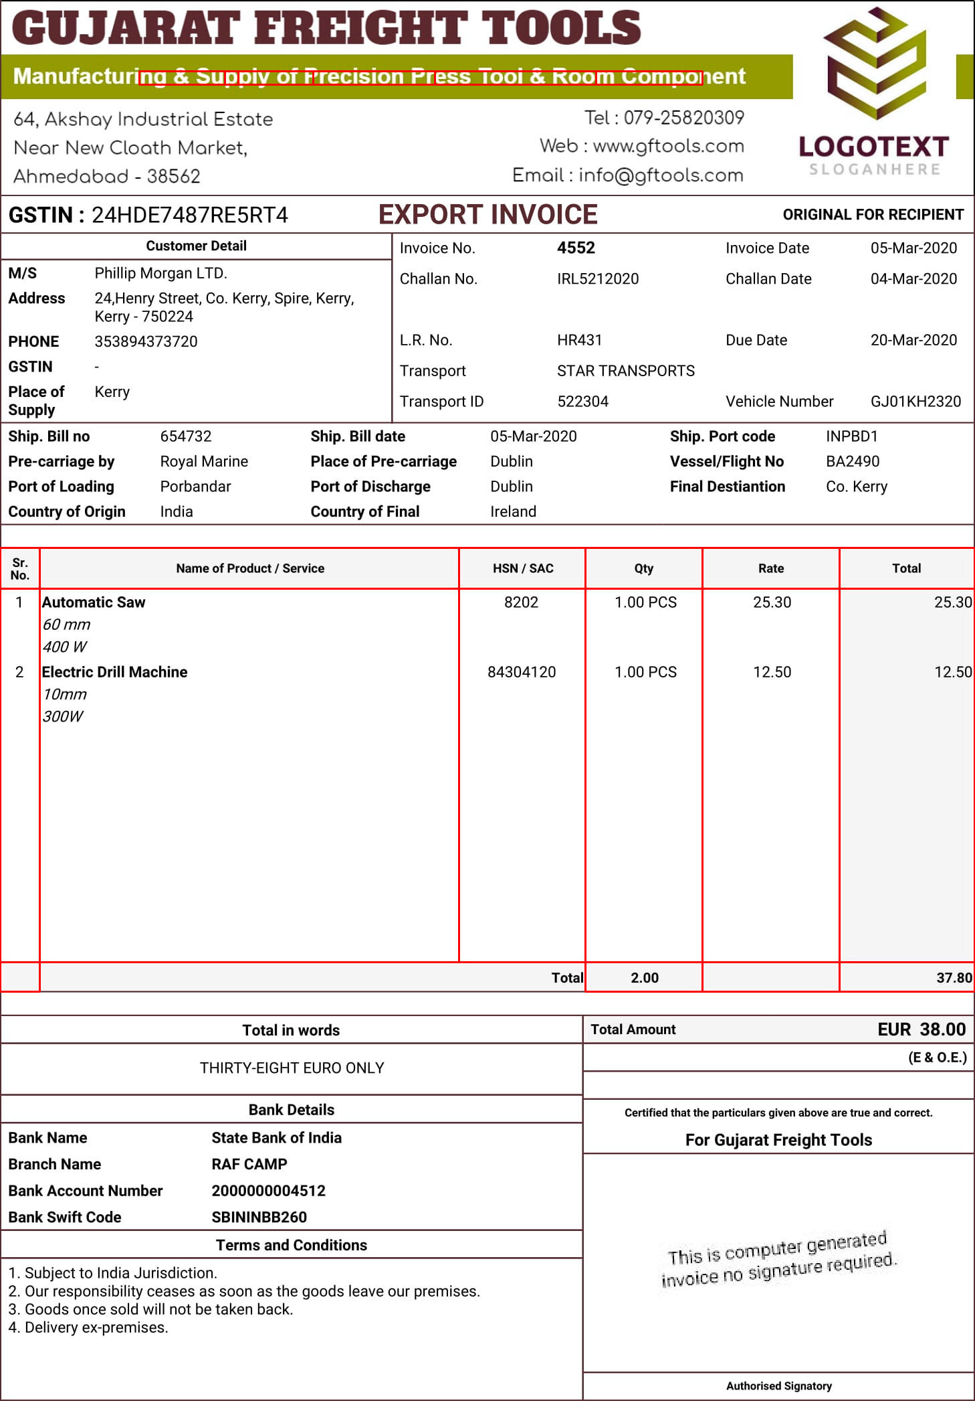
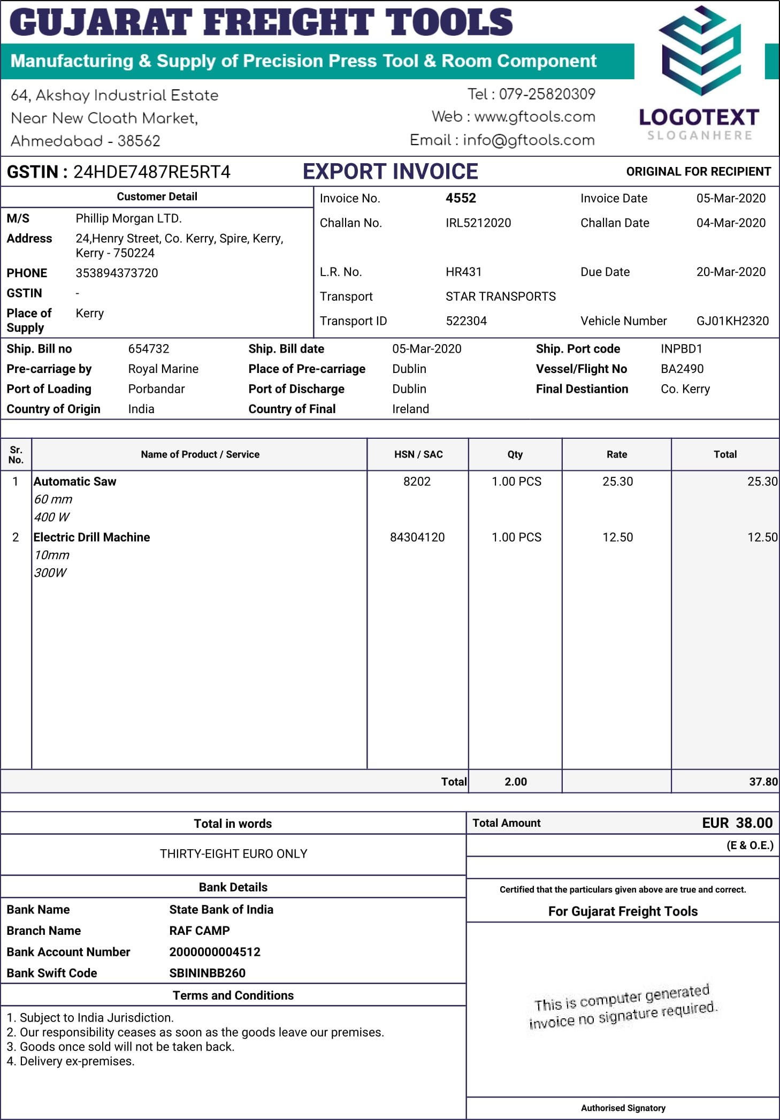
Image2table output
1. Table Detection Limitation:- Unable to detect anything which is not in table format.
2. Text Recognition Challenges- Doesn’t properly differentiate between alpha-numeric texts.
Ineffective differentiation of alpha-numeric texts.
3. Image Format Compatibility Issue: - Cannot support various image format types.
Drawbacks

Slide 6
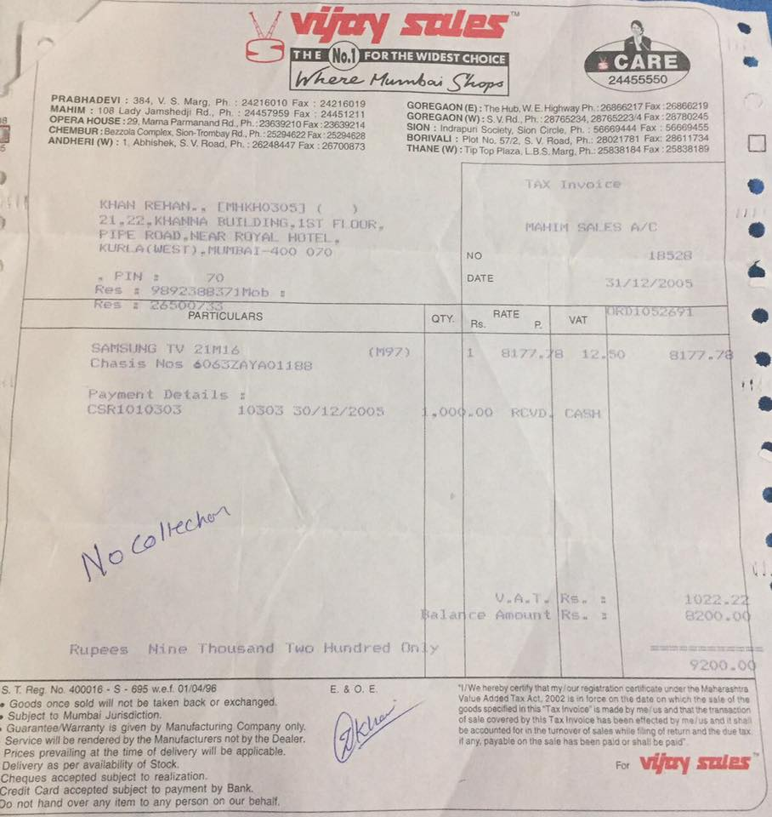
21 KHANNA MUfLDING_ IST FL @UR NciM SAES FC FIFE ROAD NGAR ROAL HCTFI KURI A( WCST).TiMaai 400 070 NO 10528 FUH 70 DATE 31712/2005 Res 9892388371iob Fe 3650 PARTICULAAS OTY RaTE VAT 7R0o5z571 SAriSVNG TV 21016 (157) 817/.a 42-60 8177-78 Chasis Nos Go63zayA0ij88 Poyment Detail5 CSRT010SOS 1050 Sofizzoos 00q 0o RCUDi CASH
Easyocr output
Text Recognition Limitations:-
Unable to capture alpha-numeric texts.
Ambiguity in discerning similar-looking words.
Inadequate differentiation between capital and small letters.
Customization and Fine-Tuning Challenges:-
EasyOCR lacks extensive customization and fine-tuning capabilities.
Drawbacks

Slide 7
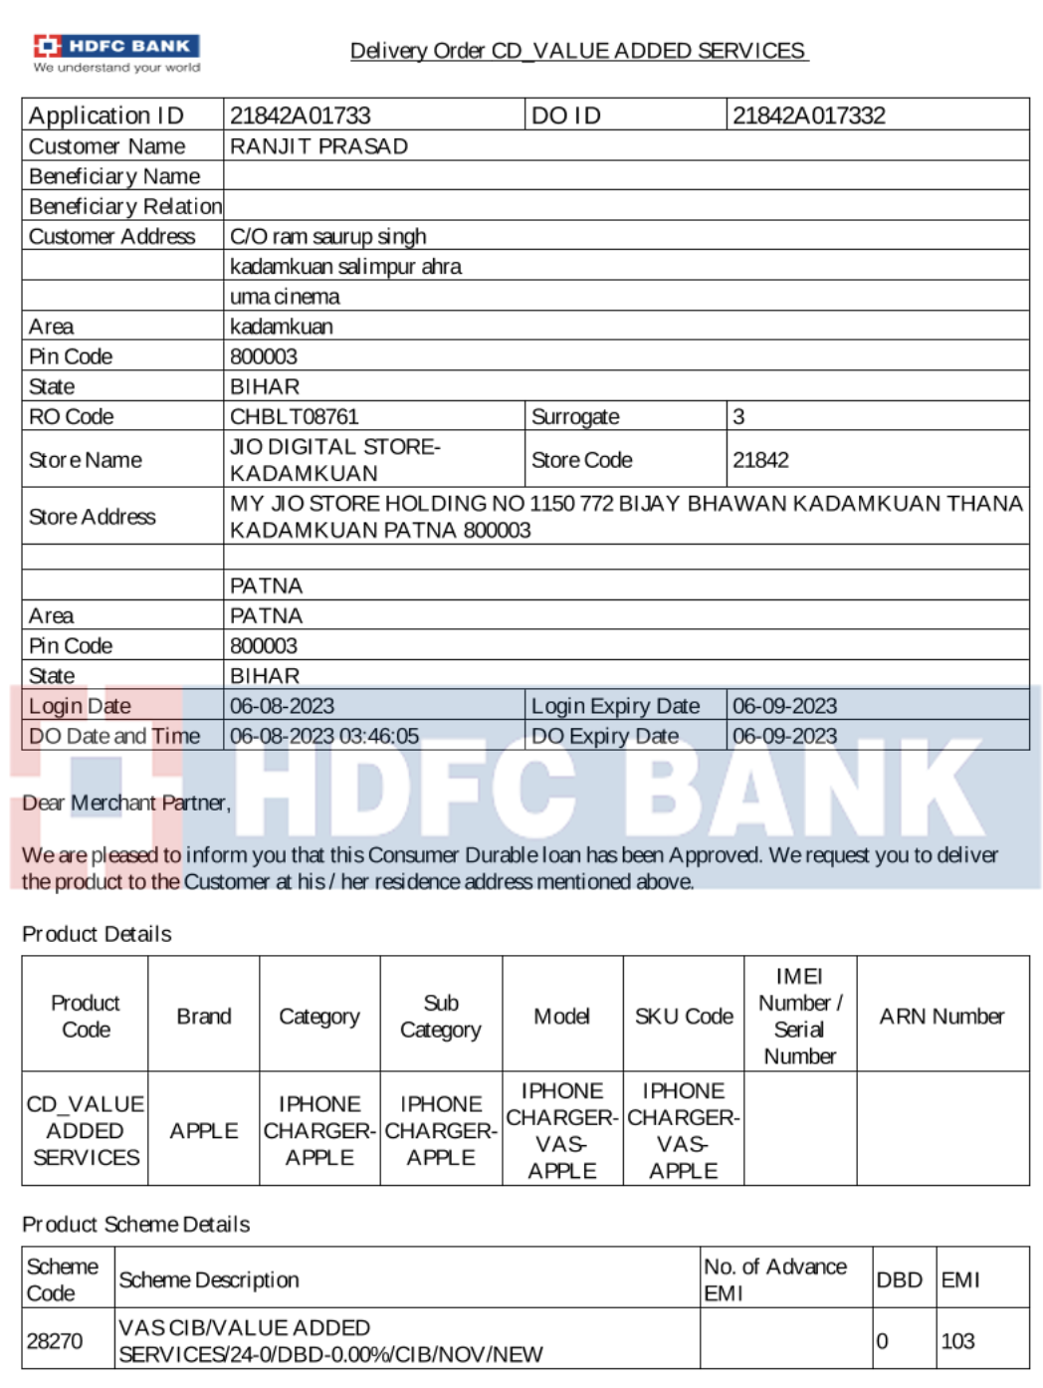
DO Reading Using PYTESSERACT – Sample 12
INPUT
PYTESSERACT OUTPUT
Customer Address | Customer Name | DO Date and Time | DO ID | Login Date | PIN code | RO Code | State | Store Address | Store Name
_CO a a aaa a aaaa | RANJIT PRASAD | None | 21842A017332 | 6/8/2023 | 800003 | CHBLTO8761 | BIHAR | MY JIO STORE HOLDING NO 1150 772 BIJAY BHAWAN ... | None

Slide 8
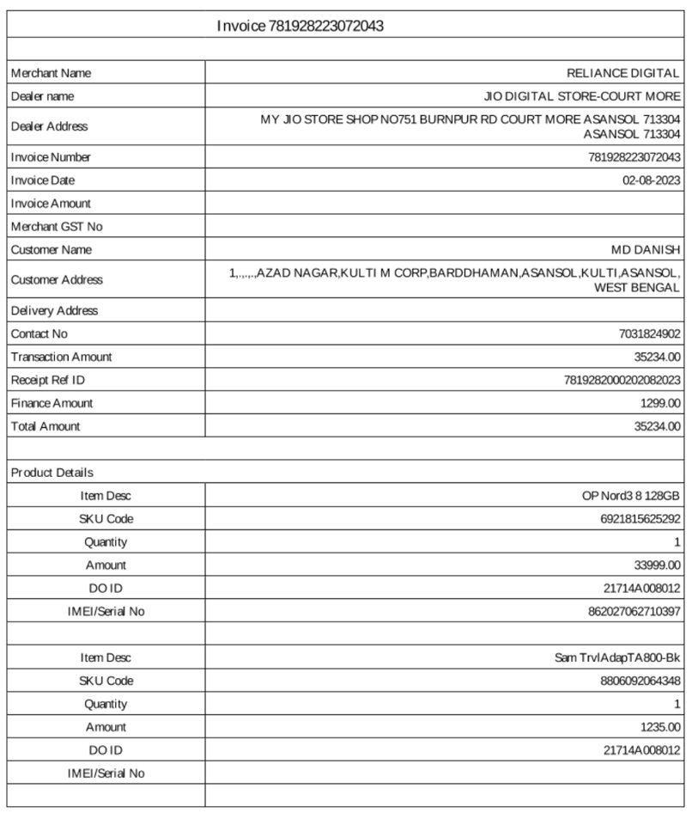
Invoice Reading Using PYTESSERACT – Sample 1​
INPUT
PYTESSERACT OUTPUT
Merchant Name RELIANCE DIGITAL
Deder name JO DIGITAL STORE-COURT MORE|
Deeler Address MY 410 STORE SHOPNOTS1 BURNFUR RD COURT MORE ASANSDL 713904
Invoice Number 781928223072043
Invoice Date 02-08-2023,
Customer Name MD DANISH
Customer Adkrese JnnniAZAD NAGARKULTI M CORPBARDDHAMAN ASANSOL KULTLASANSOL,
Delivery Address
boID 21714A008012
Customer Address | Customer Name | DO ID | Dealer Address | Dealer Name | Invoice Date | Invoice Number | Merchant Name | Total Amount
None | MD DANISH | 21714A008012 | MY 410 STORE SHOPNOTS1 BURNFUR RD COURT MORE A... | None | 02-08-2023, | 781928223072043 | RELIANCE DIGITAL | 35234

Slide 9
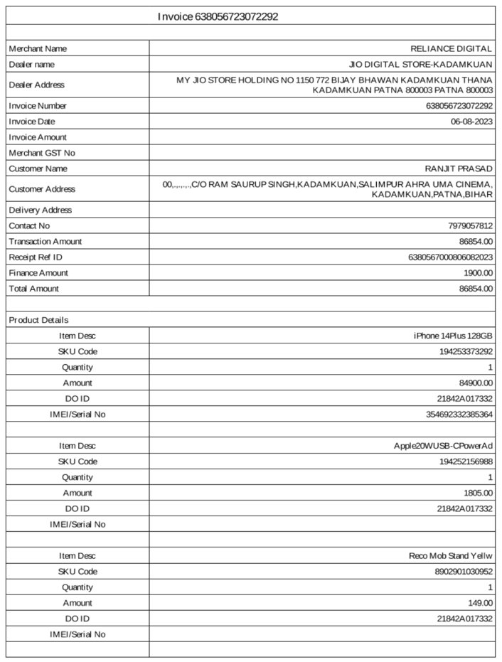
Invoice Reading Using PYTESSERACT – Sample 2
INPUT
PYTESSERACT OUTPUT
Merchant Name RELIANCE DIGITAL
Dealer name JO DIGITAL STORE-KADAMKUAN,
Deeler Address MY J1O STORE HOLDING NO 1150772 BAY BHAWAN KADAMKUAN THANA, KADAMKUAN PATNA 800003 PATNA 800003|
Customer Address KADAMKUAN,PATNA, BIHARv
boID 218424017332
Drawbacks
Word Identification Issues:
Cannot identify similar-looking words.
Joint words are not detected properly.
2. Spelling Accuracy Concerns:-
Spelling mistakes.

Slide 10
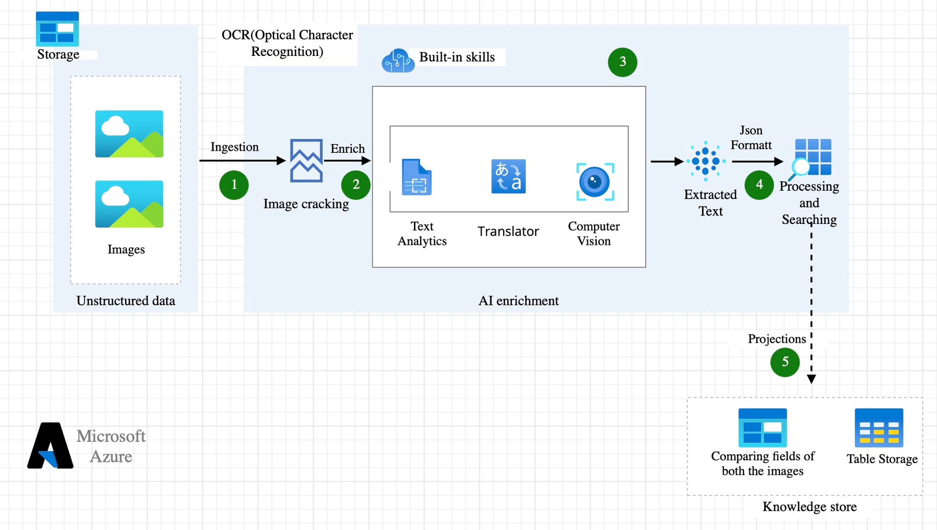
Architectural Design – Azure AI Studio

Slide 11
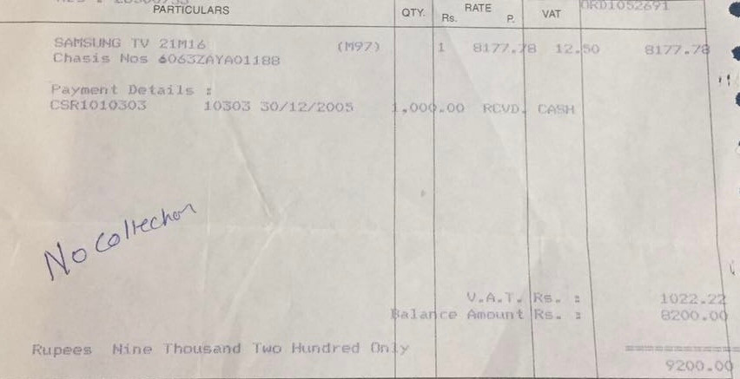
PYTESSERACT VS AZURE VISION STUDIO
Detection with pyTesseract
Detection with Azure AI - Vision Studio​
SAMSUNG TY 2im16 (ng7) 1. 9177.48 12.) Chasis
Nos 6065zAYA011a8.
Rupees Mine Thousand Two Hundred 00%. Ane
Amount alance On ES we :
SAMSUNG TV 21M16 M97 8177.78 Chasis Nos
6063ZAYA01188 12.50 8177.78.
V.A.T. Rs. : 1022.22 Balance Amount Rs.: 8200.00 Rupees Nine Thousand Two Hundred Only 9200.00

Slide 12
Pytesseract vs Azure AI
 | Pytesseract | Azure AI Computer Vision Service
Functionality | Limited to OCR, primarily text extraction from images. | Comprehensive set of computer vision capabilities, including OCR, image analysis, object detection, and facial recognition.
Integration | Requires manual setup and dependencies, less integrated with cloud services. | Seamlessly integrates into the Azure ecosystem, enabling easy connections with other Azure tools and services.
Scalability | Limited scalability when deployed locally; additional efforts required for cloud scaling. | Designed as a cloud-based service, offering automatic scalability to handle varying workloads globally.
Enterprise-Grade Features | Limited enterprise-level features, suitable for smaller projects. | Provides enterprise-grade features with robust security, compliance, and support, making it suitable for large-scale applications.

Slide 13
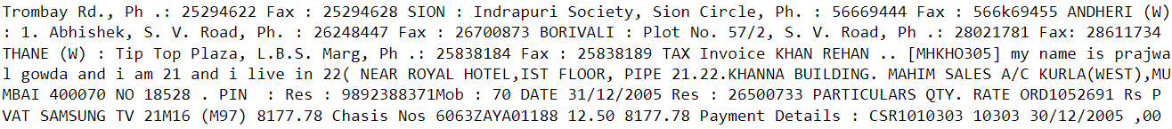

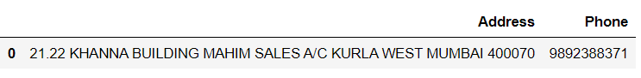
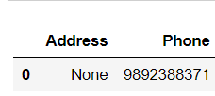
Output FTR VS FTNR
Extracted Text-Bill
Matcher Algorithm
If Match % > threshold (%)
Extracted Text-HDFC Bill
<=70%
70%>
FTR

Slide 14
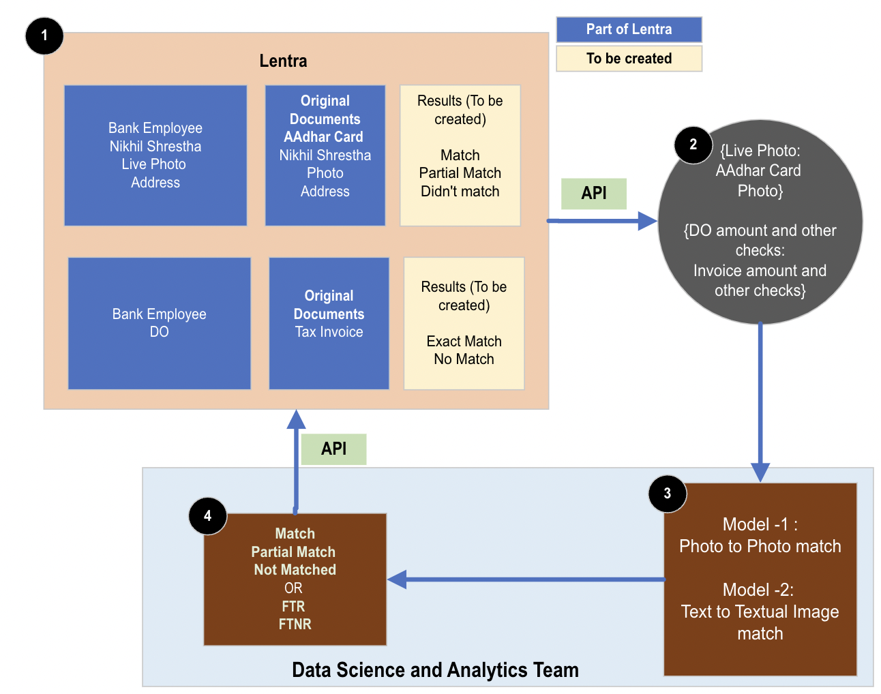
Approach-1 Using Lentra API calling

Slide 15
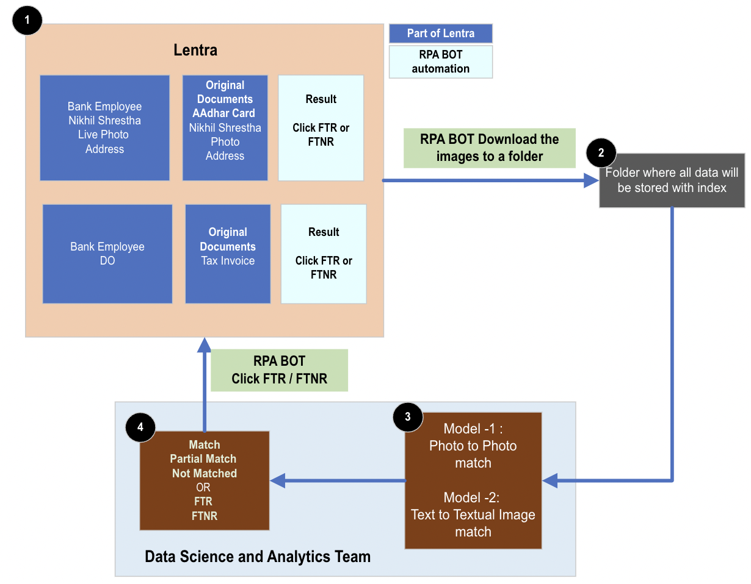
Approach-2 Using RPA BOT

